Slide 1
Cyber Security

Slide 2
Email & Domain Information Gathering
It is also known as reconnaissance, involves collecting data from publicly available sources to understand the target's online presence and potential vulnerabilities.

Slide 3
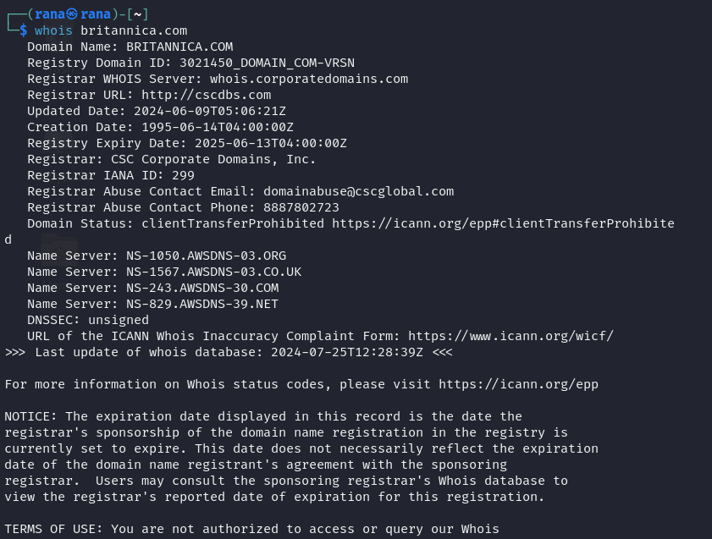
Examples:- WHOIS Lookup
WHOIS Lookup is a query and response protocol used to obtain information about the owner of a domain name, IP address, or an autonomous system on the Internet. It provides details such as the registrant's name, contact information, and the domain's registration and expiration dates.

Slide 4
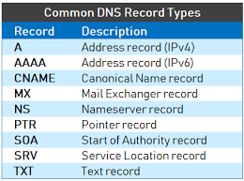
DNS Records Analysis
it involves examining the Domain Name System records to uncover details about domain ownership, IP addresses, and the mail servers associated with a domain.

Slide 5
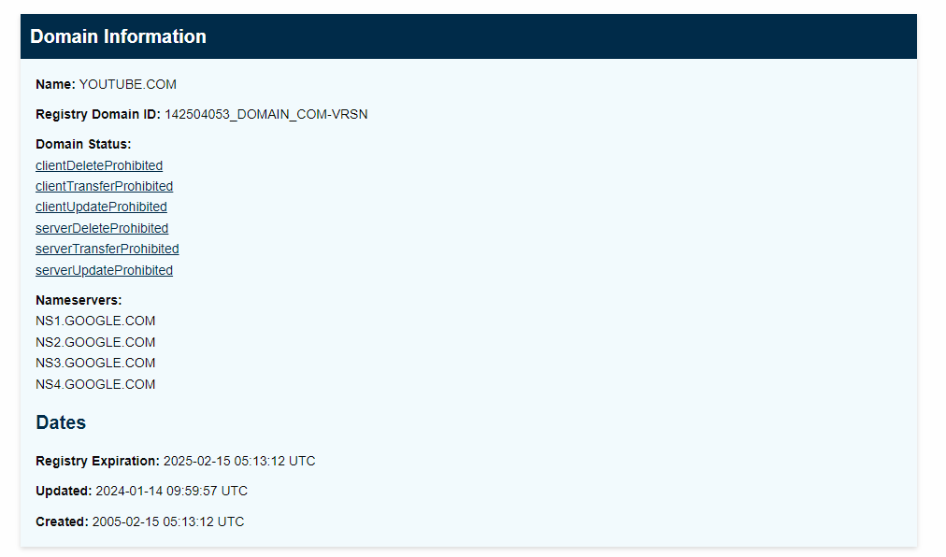
Techniques and Tools/Websites:-
WHOIS Lookup:
Command :
who is britannica.com
Website:
https://lookup.icann.org/en/lookup
https://lookup.icann.org/en/lookuphttps://lookup.icann.org/en/lookup
https://lookup.icann.org/en/looku
https://lookup.icann.org/en/lookup

Slide 6
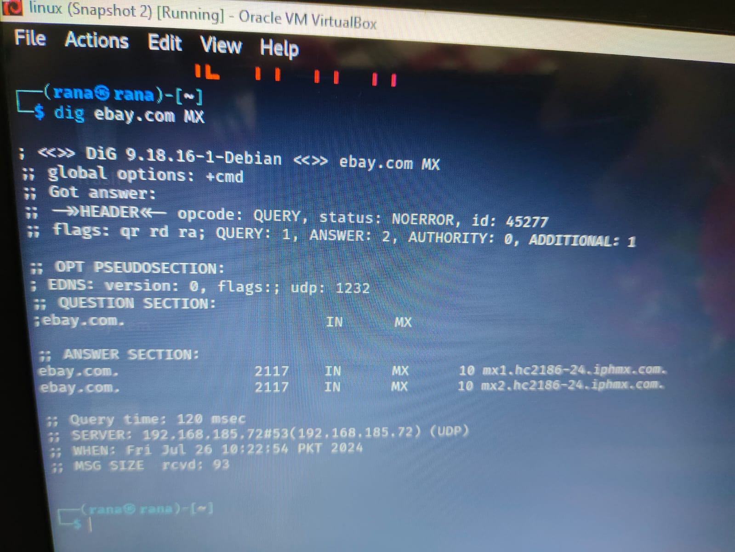
DNS Records Analysis:
Techniques and Tools/Websites:
Command: dig youtube.com MX

Slide 7
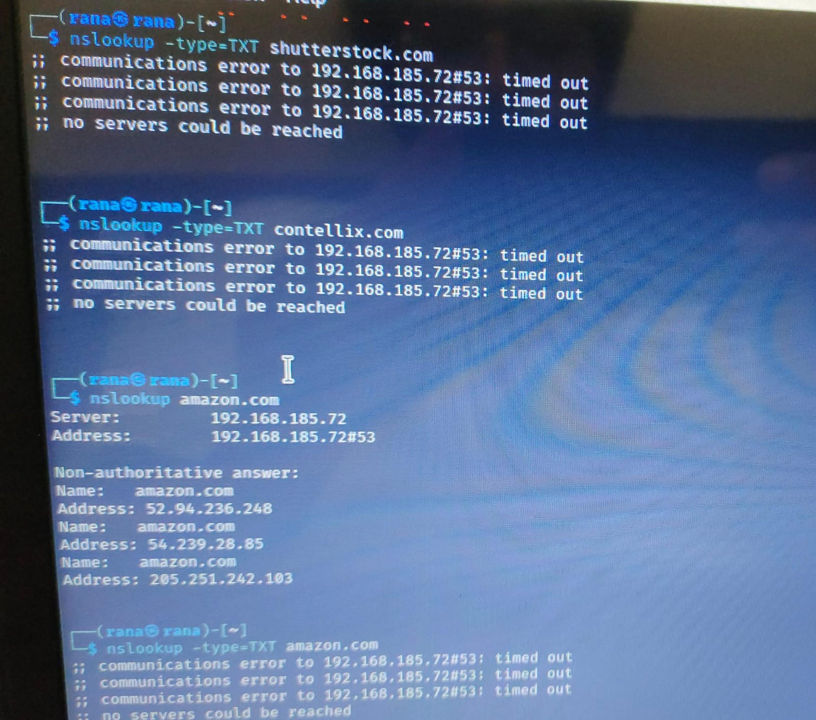
Command:
nslookup -type=TXT amazon.com

Slide 8
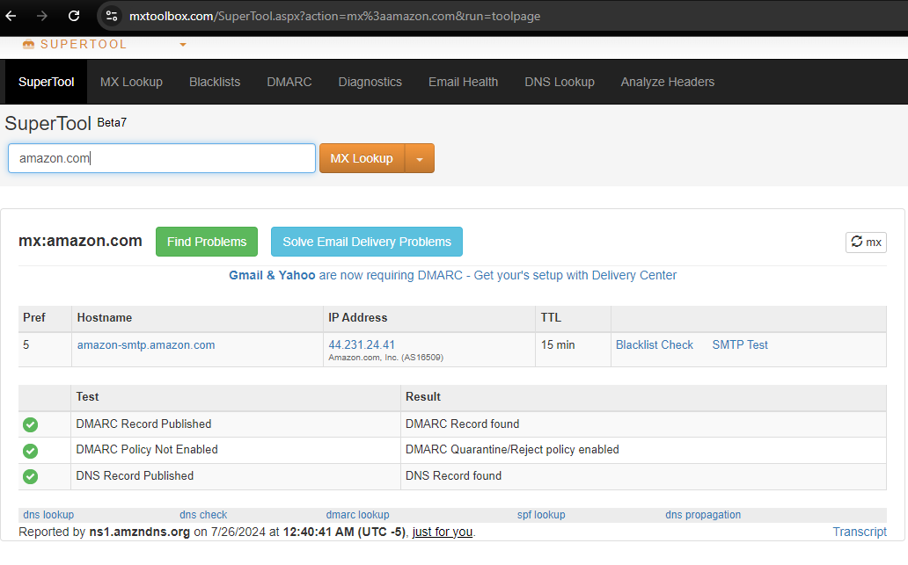
Website:
MXtoolbox

Slide 9
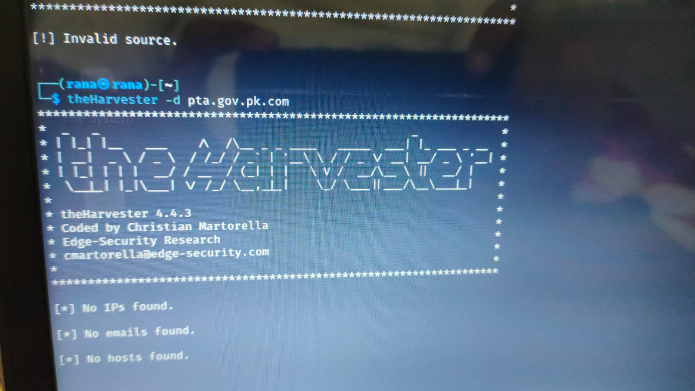
Email Address Search:
Techniques: Search for email addresses associated with a domain using public databases and search engines.
Tool:
theHarvester -d pta.gov.pk.com -b google
Website:
Hunter.io

Slide 10
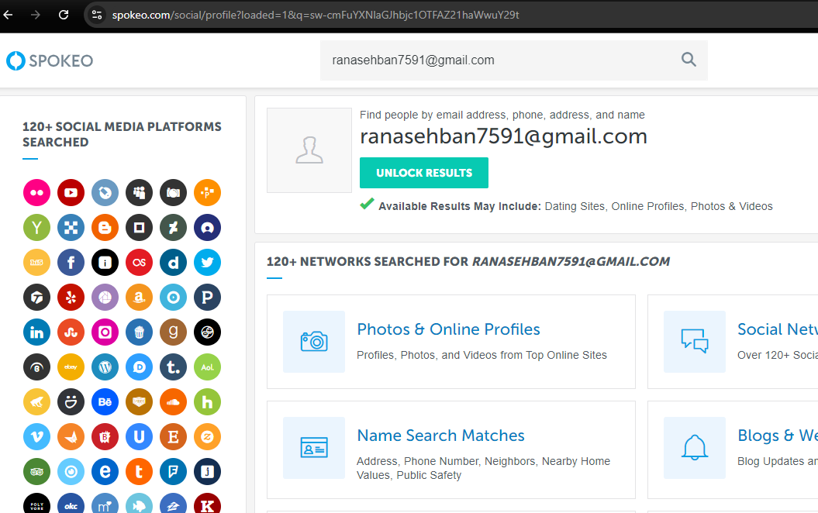
Reverse Email Lookup:-
Websites:
Pipl
spokeo

Slide 11
Metadata Analysis:-
It include information about the file creation date, author, software used, and other details that are embedded within the file.

Slide 12
Document Metadata Extraction:-
Extracting metadata from a PDF file to find out the author, creation date, and software used to create the document
Tools/Websites:
Tool: exiftool exiftool document.pdf
Tool: FOCA foca-cli -f document.pdf

Slide 13
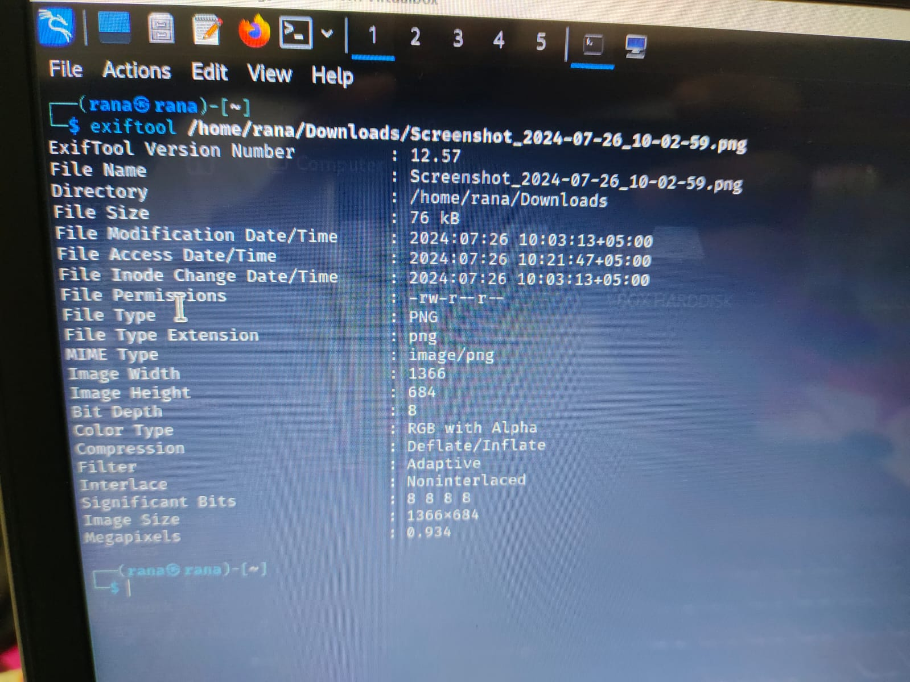
Image Metadata Analysis:
Extracting EXIF data from a JPEG image to find out the camera model, GPS location, and date/time the photo was taken.
Tools/Websites:
Tool: exiftool exiftool image.jpg
Tool: FOCA foca-cli –f image.jpg

Slide 14
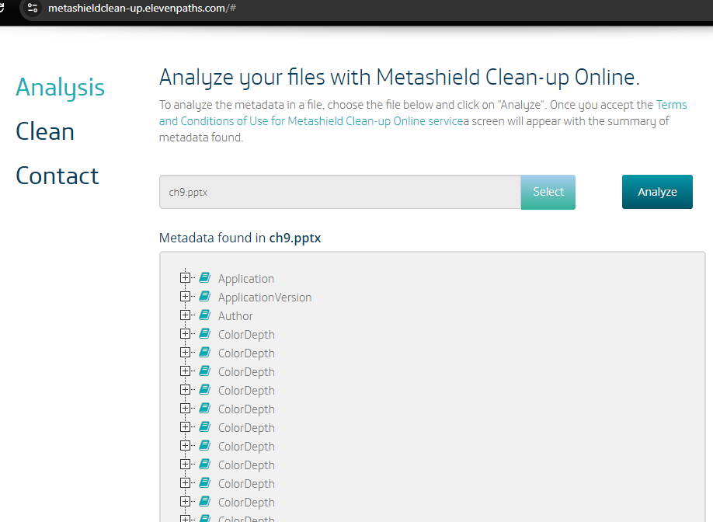
i
Online Metadata Analyzers:
Metashield analyzer
Get-MetaData

Slide 15
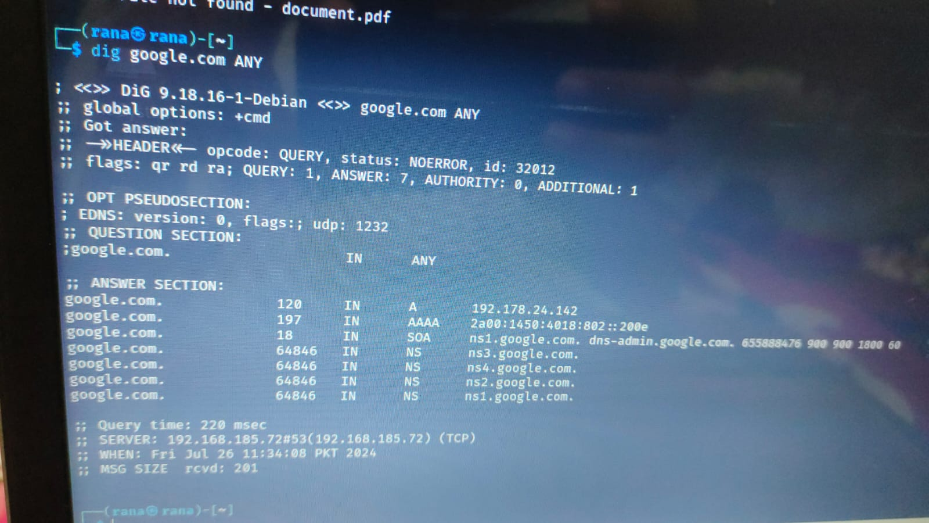
DNS Enumeration:
process of collecting detailed information about a domain's DNS (Domain Name System) records.
DNS Queries:
Tools/Websites:
Command: dig google.com ANY
Command: nslookup -type=ANY google.com.com
Website: MXToolbox

Slide 16
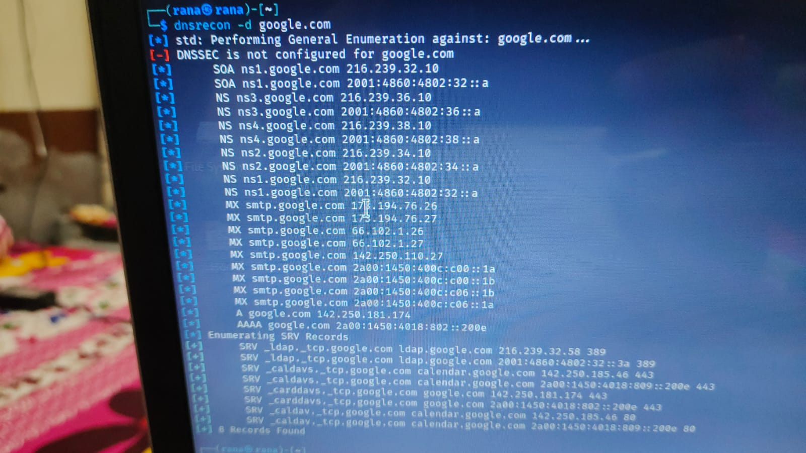
DNS Enumeration Tools:
Tool: dnsenum
dnsenum example.com
Tool: dnsrecon
dnsrecon -d google.com
Tool: fierce
fierce -dns example.com

Slide 17
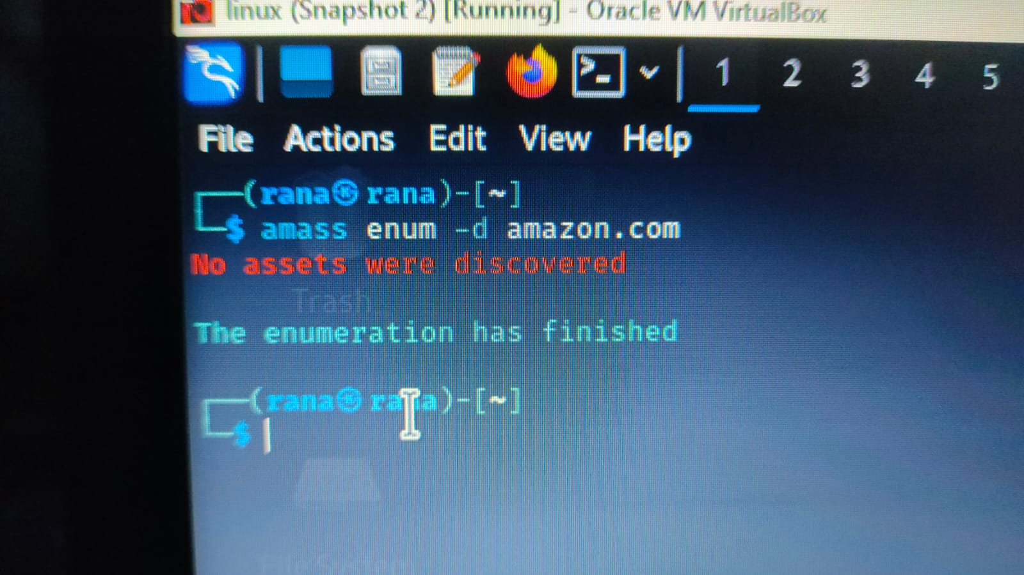
Subdomain Enumeration:
Tools:
Tool: sublist3r sublist3r -d amazon.com
Tool: amass amass enum -d amazon.com
Website: VirusTotal (for discovering subdomains via DNS records)

Slide 18
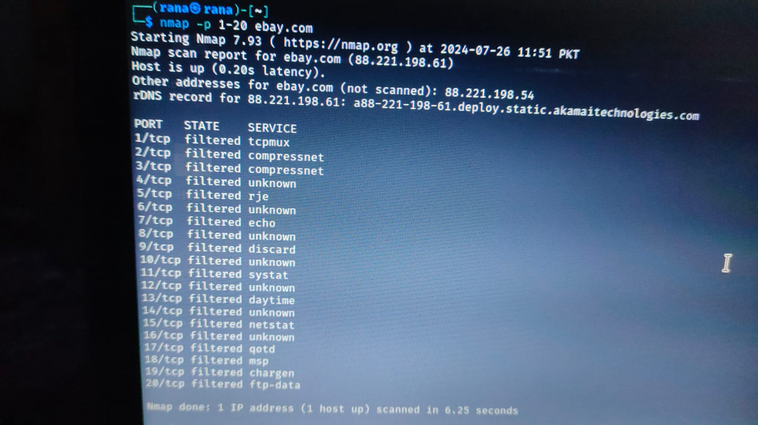
Enumeration of Network Services:-
process of identifying active services running on a network, such as web servers, FTP servers, email servers, and other types of networked applications.
Examples:-
Port Scanning:
Nmap: nmap -p 1-65535 google.com
Masscan (for very large networks or fast scans): masscan -p1-65535 192.168.1.0/24

Slide 19
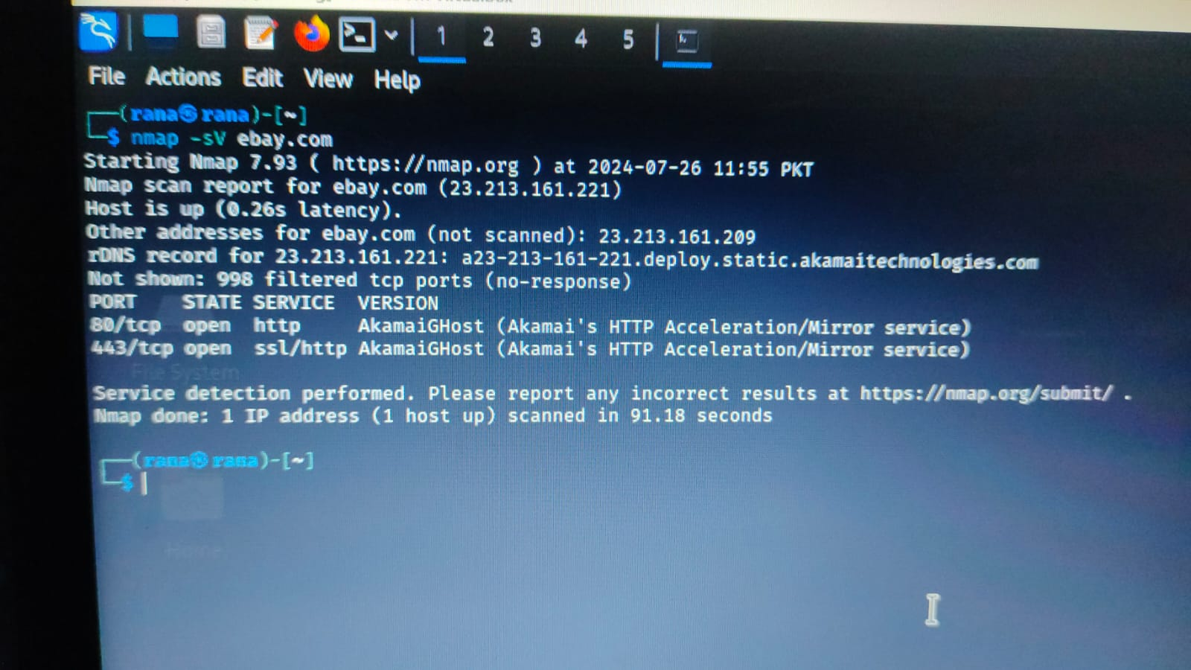
Service Version Detection:
Tools:
Nmap with version detection: nmap -sV google.com
Banner Grabbing with Netcat: nc -v example.com 80

Slide 20
Thank you

